Slide 1
Lecture 4 Linear Programming II

Slide 2
Agenda
Graphical LP solution
“Special cases” of LP solutions
Infeasible
Multiple optimal solutions
Unbounded
LP formulation guidelines
Formulation examples
Work scheduling
Blending II
RV problem (product mix)

Slide 3
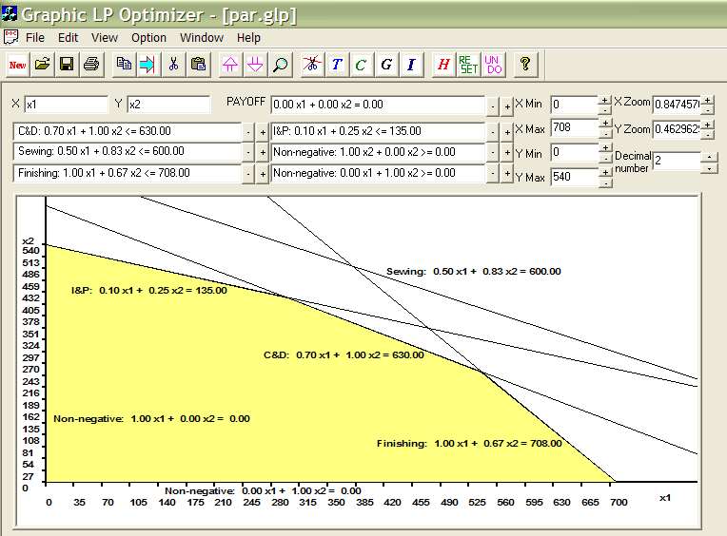
Graphical Solution-Feasible Region
Par Problem
Objective Maximize 10 x₁ + 9 x₂
Subject to:
Cutting & Dyeing: 7/10 x₁ + x₂ ≤ 630
Sewing: 1/2 x₁ + 5/6 x₂ ≤ 600
Finishing: x₁ + 2/3 x₂ ≤ 708
Inspection & Packaging: 1/10 x₁+ 1/4 x₂ ≤ 135
Non-negative: x₁ ≥ 0 , x₂ ≥ 0
Plot the feasible region

Slide 4
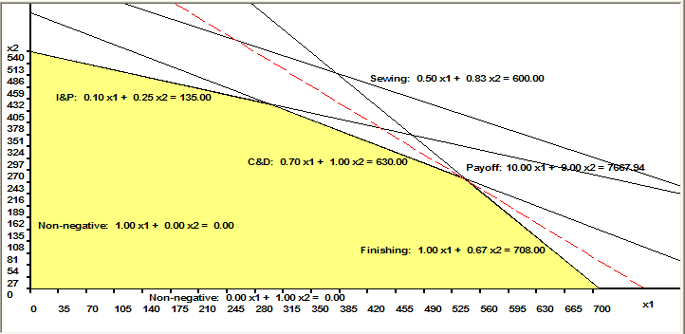
Graphical Solution-Objective Function
Objective Maximize 10 x₁ + 9 x₂
Iso-profit lines
3D view of the profit function
Optimal solution (x₁, x₂) should be one of the corner
points of the feasible region.

Slide 5
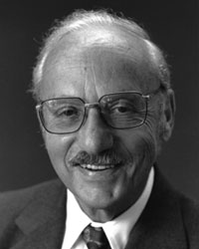
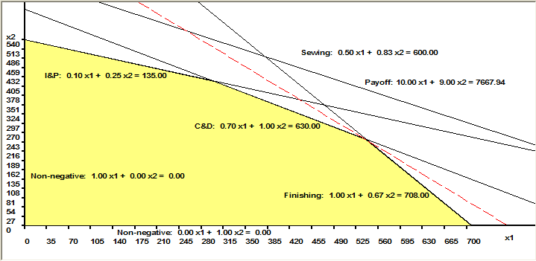
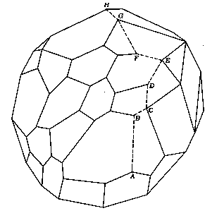
Graphical Solution – Cont’d
Binding constraints: C&D, Finishing
Slack constraint: I&P
Redundant constraint: Sewing
Note: Simplex Method (by George Dantzig, 1947)
1. Start with a feasible corner point solution
2. Check to see if a feasible neighboring corner
point is better
3. If not, stop; otherwise move to that better neighbor
and return to step 2.
Starting at A, the simplex method
proceeds from vertex to vertex until
it reaches an optimal value at H.

Slide 6
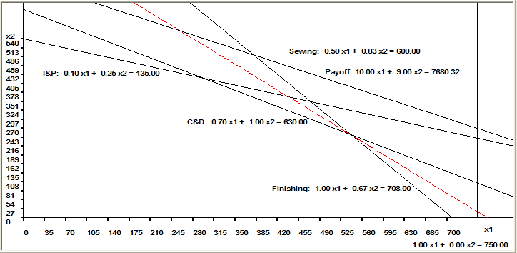
Special Cases of LP Solution: Inconsistent Problem
Par Example:
Assume there is an additional constraint: need to produce at least 725 standard bags,
i.e., x1 ≥ 725
Profit Contribution Maximize 10 x₁ + 9 x₂
ST
Cutting & Dyeing: 7/10 x₁ + x₂ ≤ 630
Sewing 1/2 x₁ + 5/6 x₂ ≤ 600
Finishing x₁ + 2/3 x₂ ≤ 708
Inspection & Packaging 1/10 x₁ + 1/4 x₂ ≤ 135
x₁ ≥ 725
x₁ ≥ 0 , x₂ ≥ 0

Slide 7
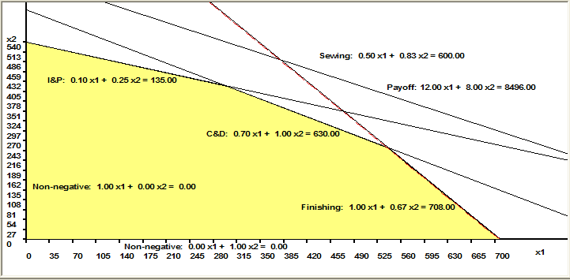
Special Cases of LP Solution: Multiple Optimal Solutions
Par Example:
Assume the profit contribution of the standard bag is $12 and the profit contribution of the deluxe bag is $8.
Profit Contribution Maximize 12 x₁ + 8 x₂
ST
Cutting & Dyeing: 7/10 x₁ + x₂ ≤ 630
Sewing 1/2 x₁ + 5/6 x₂ ≤ 600
Finishing x₁ + 2/3 x₂ ≤ 708
Inspection & Packaging 1/10 x₁ + 1/4 x₂ ≤ 135
Non-negative: x₁ ≥ 0 , x₂ ≥ 0

Slide 8
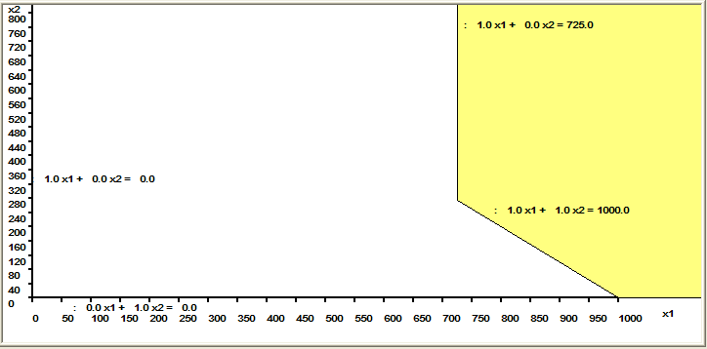
Special Cases of LP Solution: Unbounded Problem
Suppose we have the following problem:
Maximize 10 x₁ + 9 x₂
Such that:
x₁ + x₂ ≥ 1000
x₁ ≥ 725
x₁ ≥ 0 , x₂ ≥ 0

Slide 9
Summary of Special Cases
Special cases | Graphical | Excel Solver Message | Managerial Implication
Inconsistent problem | Feasible region does not exist | “Solver could not find a feasible solution” | Too many restrictions
Multiple optimal solutions | Slope of the objective function is the same as that of one constraint | Give one optimal solution
Unbounded problem | Optimal objective function value is infinite | “The Set Cell values do not converge” | Problem is improperly formulated: too few constraints, wrong objective function

Slide 10
LP Formulation Guidelines
Formulation: also called modeling, the process of translating a verbal statement of a problem into a mathematical statement.
Guidelines for formulation
1. Understand the problem
2. Ask the following three questions:
(i) What must be decided? What are the decision
variables?
(ii) What measure should we use to compare alternative
sets of decisions?
(iii) What restrictions limit our choices?
3. Write the mathematical representation of the objective function in terms of the decision variables
4. Write the constraints in terms of the decision variables
5. Check your formulation!
-Does it make sense?
-Is there any data in the problem you haven’t used?

Slide 11
Work Scheduling Example
A post office requires different numbers of full-time employees on different days of the week. The minimum number of full-time employees needed on each day is as follows:
Monday 7
Tuesday 3
Wednesday 5
Thursday 9
Friday 4
Saturday 6
Sunday 1
Union rules state that each full-time employee must work five consecutive days and then receive two days off. For example, an employee who works Monday to Friday must be off Saturday and Sunday. The post office wants to meet its daily requirements using only full-time employees. Formulate an LP that the post office can use to minimize the number of full-time employees that must be hired.

Slide 12
Work Scheduling Problem Formulation
Data for the Work Scheduling Problem
1. What must be decided? What are the decision variables?
2. What measure should we use to compare alternative sets of decisions?
3. What restrictions limit our choices?

Slide 13
Work Scheduling Problem Formulation
4. Formulate the objective function:
5. Formulate the constraints:
6. Do we need non-negativity constraints?
7. Write down the total problem formulation:

Slide 14
Blending Example II
The Java Junkie Coffee Shop blends coffee on the premises for its customers. It sells three basic blends in 1-pound bags: Special, Mountain Dark, and Mill Regular. It uses two different types of beans to produce the blends: Brazilian and mild. The shop used the following blend recipe requirements.
The cost of Brazilian coffee beans are $2.00 per pound and the cost of mild is $1.25 per pound. Every week the shop can buy up-to 210 pounds of Brazilian coffee beans, and 300 pounds of mild coffee beans. The shop wants to know the amount of each blend it should prepare each week and how much of each type of coffee beans to include in each blend in order to maximize profits. Assume the weekly demand to all three blends always exceeds the store’s supply.
BLEND | MIX REQUIREMENTS | SELLING PRICE ($/LB)
Special | At least 40% Brazilian No more 30% mild | 6.50
Dark | At least 60% Brazilian No more than 10% mild | 6.00
Regular | No more than 60% mild At least 30% Brazilian | 5.75

Slide 15
Blending Problem Formulation
1. What must be decided? What are the decision variables?
2. What measure should we use to compare alternative sets of decisions?
3. What restrictions limit our choices?

Slide 16
Blending Problem Formulation
4. Formulate the objective function:
5. Formulate the constraints:
6. Do we need non-negativity constraints?
7. Write down the total problem formulation:

Slide 17
RV Example
A single plant is used to assemble three RV models: Standard, Fancy, and Luxury. The plant shop capacities (in hours per week) and the times each model spends in a particular shop are given in the table below. The ``contributions” are profit per vehicle manufactured. What product mix maximizes the plant’s profit? Formulate the linear program.
Shop | Capa-city | Standard (mfg time) | Fancy (mfg time) | Luxury (mfg time)
Engine | 120 | 3 | 2 | 1
Body | 80 | 1 | 2 | 3
Standard finishing | 96 | 2
Fancy finishing | 102 |  | 3
Luxury finishing | 40 |  |  | 2
Contribution |  | $840 | $1120 | $1200

Slide 18
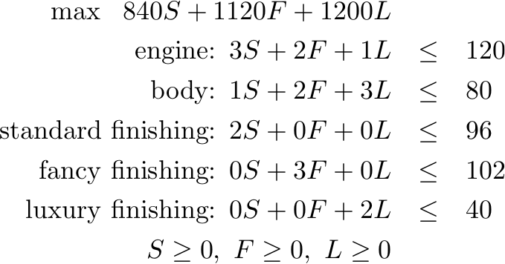
RV Example: LP Formulation
Solving the problem using Excel Solver yields (as in the previous examples):
S=20, F=30, and L=0
The value of the objective function is $50,400.
Therefore, the plant should produce standard (S) and fancy (F) at the rates of 20 and 30 per week respectively. Since 3(20)+2(30)=120 and 20+2(30)=80, this product mix keeps the engine and body shops fully utilized.

Slide 19
RV: Diseconomy of Scale
Suppose the data in the RV example are exactly as before with this exception: Each of the first 12 units of the Standard model vehicle has $840 as its contribution, and any units in excess of 12 have a contribution of $500 each. What product mix maximizes the total contribution?

Slide 20
Analysis
The model has become less profitable so we may anticipate to make fewer of them
However, it is not clear that we make fewer than twelve at $840 apiece
To re-solve this problem, we need to change the previous linear program in three ways. The first change is to introduce two new decision variables
S₁ = the number of Standard model vehicles made per week and sold a contribution of $840 each
S₂ = the number of Standard model vehicles made per week and sold a contribution of $500 each
The second and third change add constraints and change the objective function

Slide 21
Analysis
The additional constraints needed are:
The new objective function is:

Slide 22
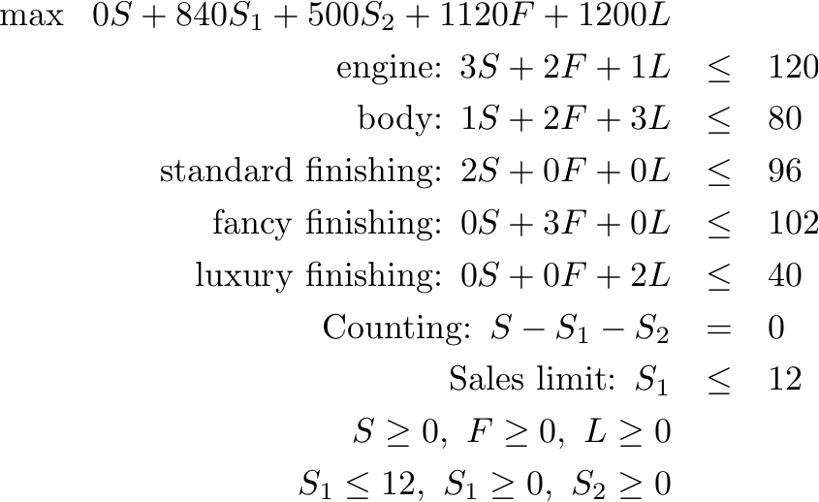
The LP Formulation then is:

Slide 23
Multiple Diseconomies of Scale
The following figure displays a different profit function that exhibits decreasing marginal return.
The analog of the approach we just employed works here as well.
This leads to the following result.

Slide 24
Multiple Diseconomies of Scale
A linear program readily accommodates decreasing marginal return, increasing marginal cost, and other diseconomies of scale.
Summary
Intuition behind the Simplex algorithm
Additional LP formulations
Accommodations of piece-wise linearity

